Slide 1
Dev Team Design Presentation
Alex Dering, Peter Russell, Dana Greene, Matthew Bell

Slide 2
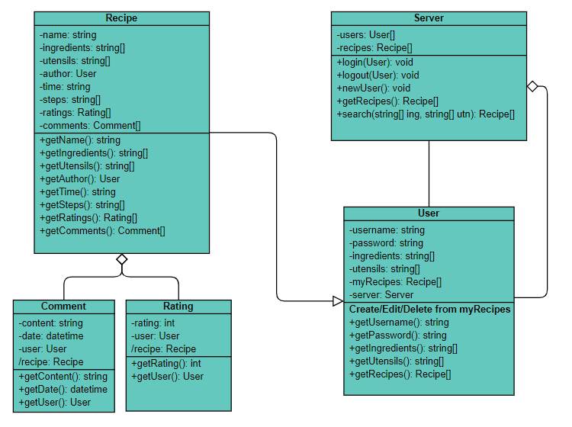
Class Diagrams

Slide 3
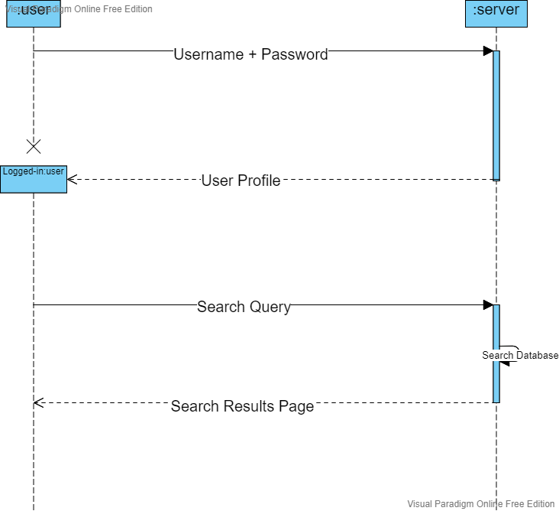
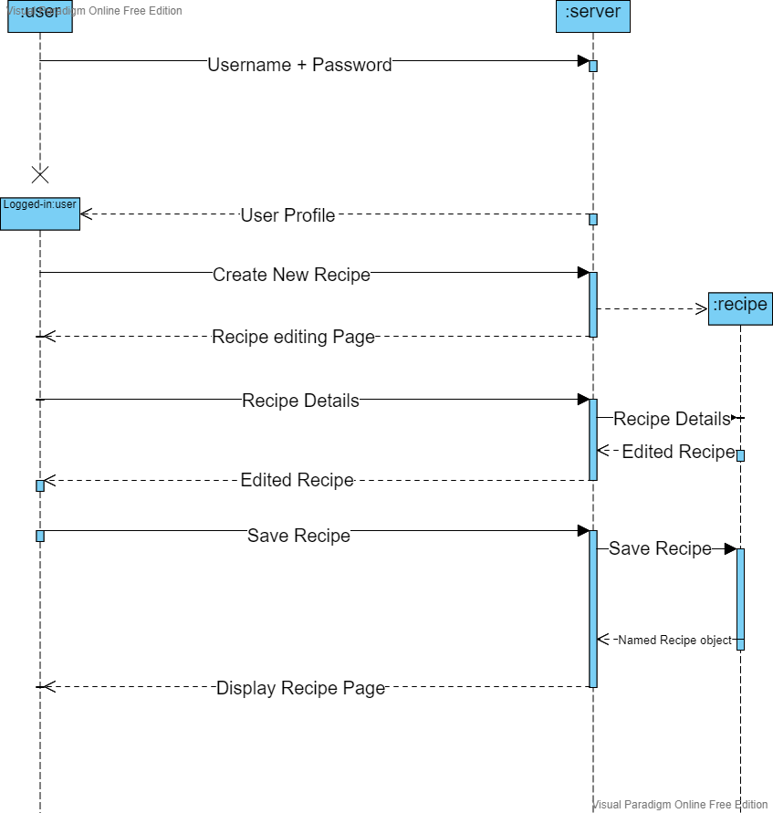
Sequence diagrams

Slide 4
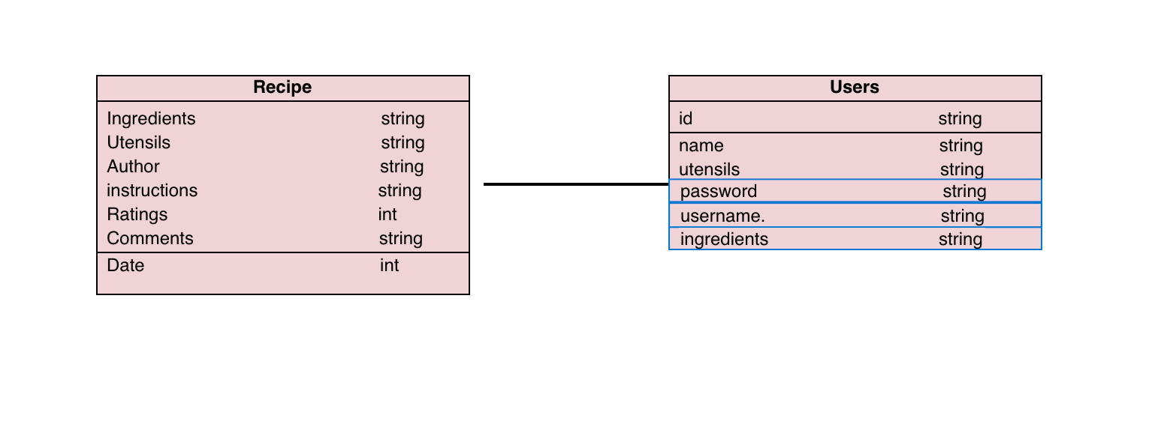
Database Diagram

Slide 5
Frontend Update
Visually improved website
Universal CSS file
Consistent banner across all web pages
Consistent colors and text
Issues
No major issues yet

